Slide 1
Announcements
The final exam is in-class on Friday. It will be mainly multiple choice questions similar to the quizzes, and it will cover all of the assigned readings.
I’m holding an extra set of office hours tomorrow from 1:30-3:30 in 3401 Walnut room 452C.
HW5 is due on Tuesday, late days are OK to use.
Today’s lecture on Computer Vision is just for fun – it’s not on the exam.

Slide 2

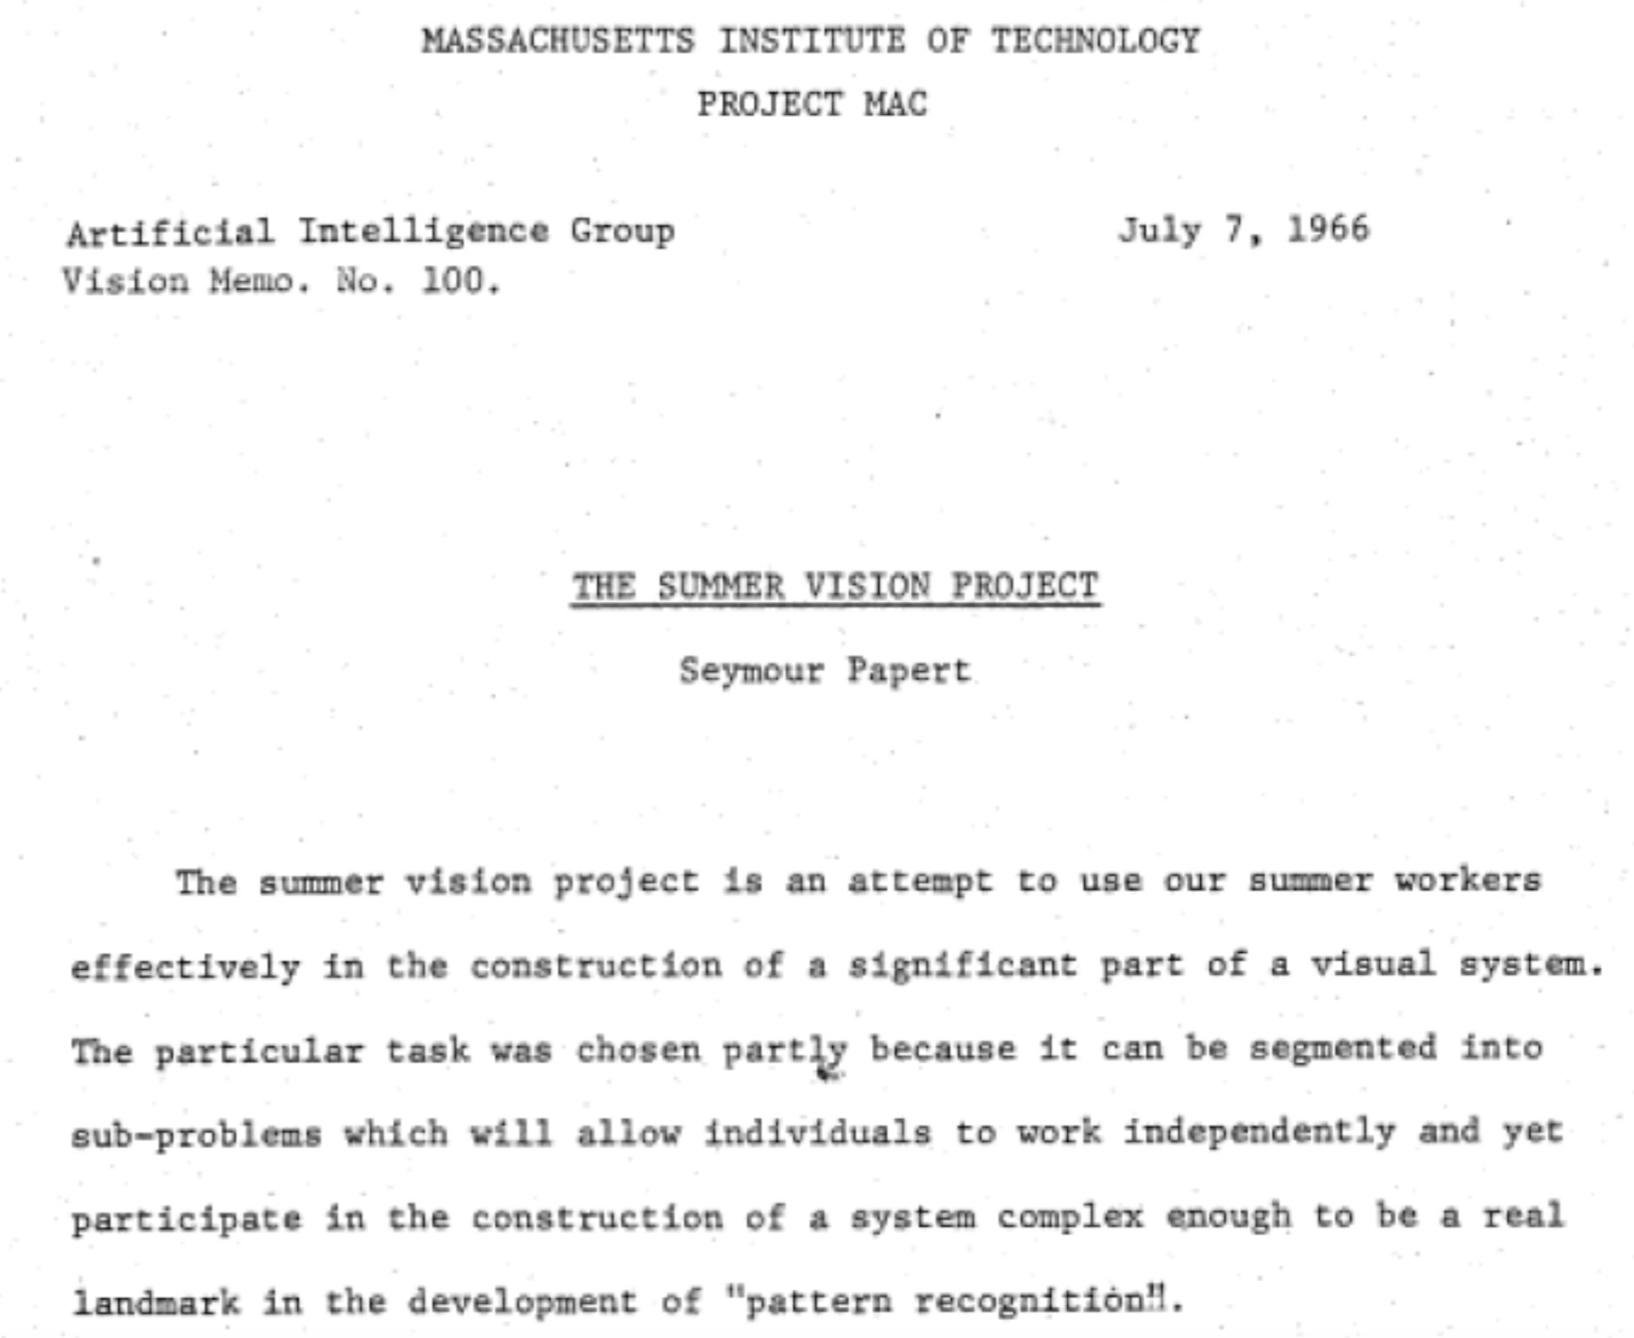
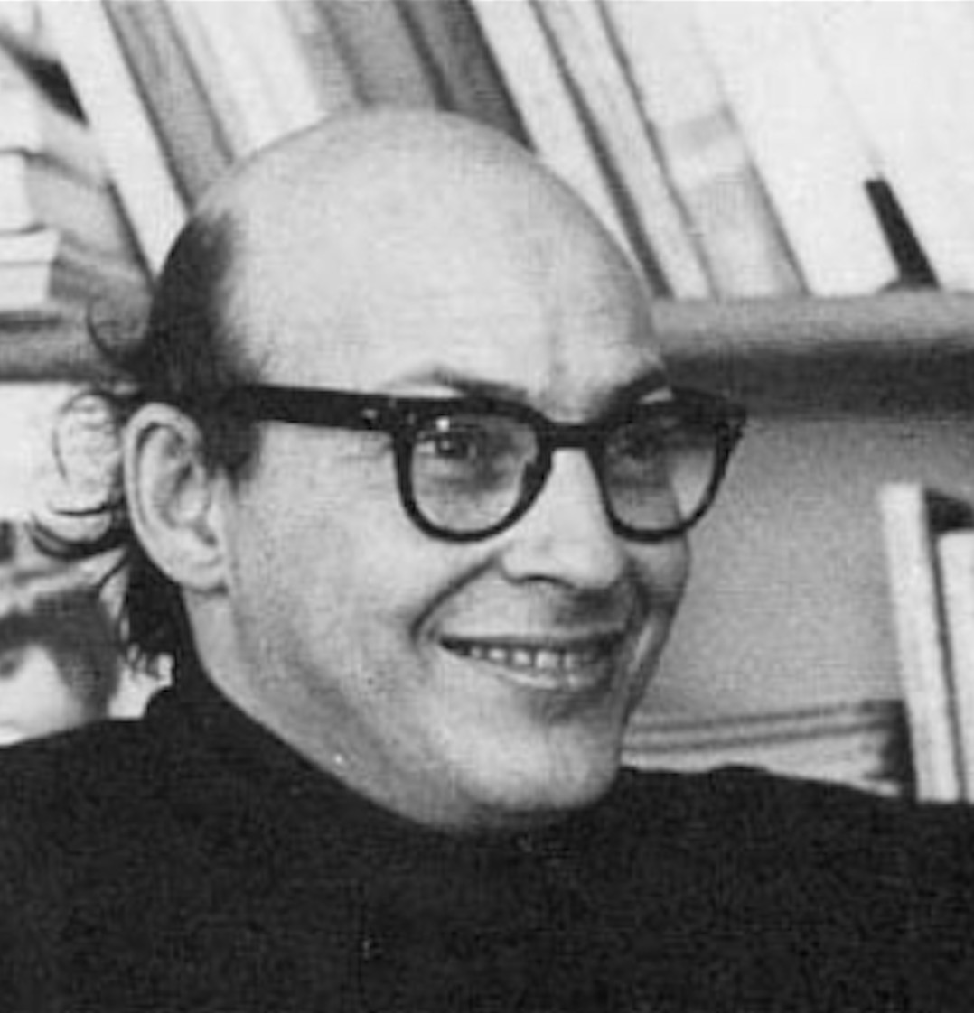
1966
“Connect a television camera to a computer and get the machine to describe what it sees.”
Marvin Minsky Turing award, 1969

Slide 3

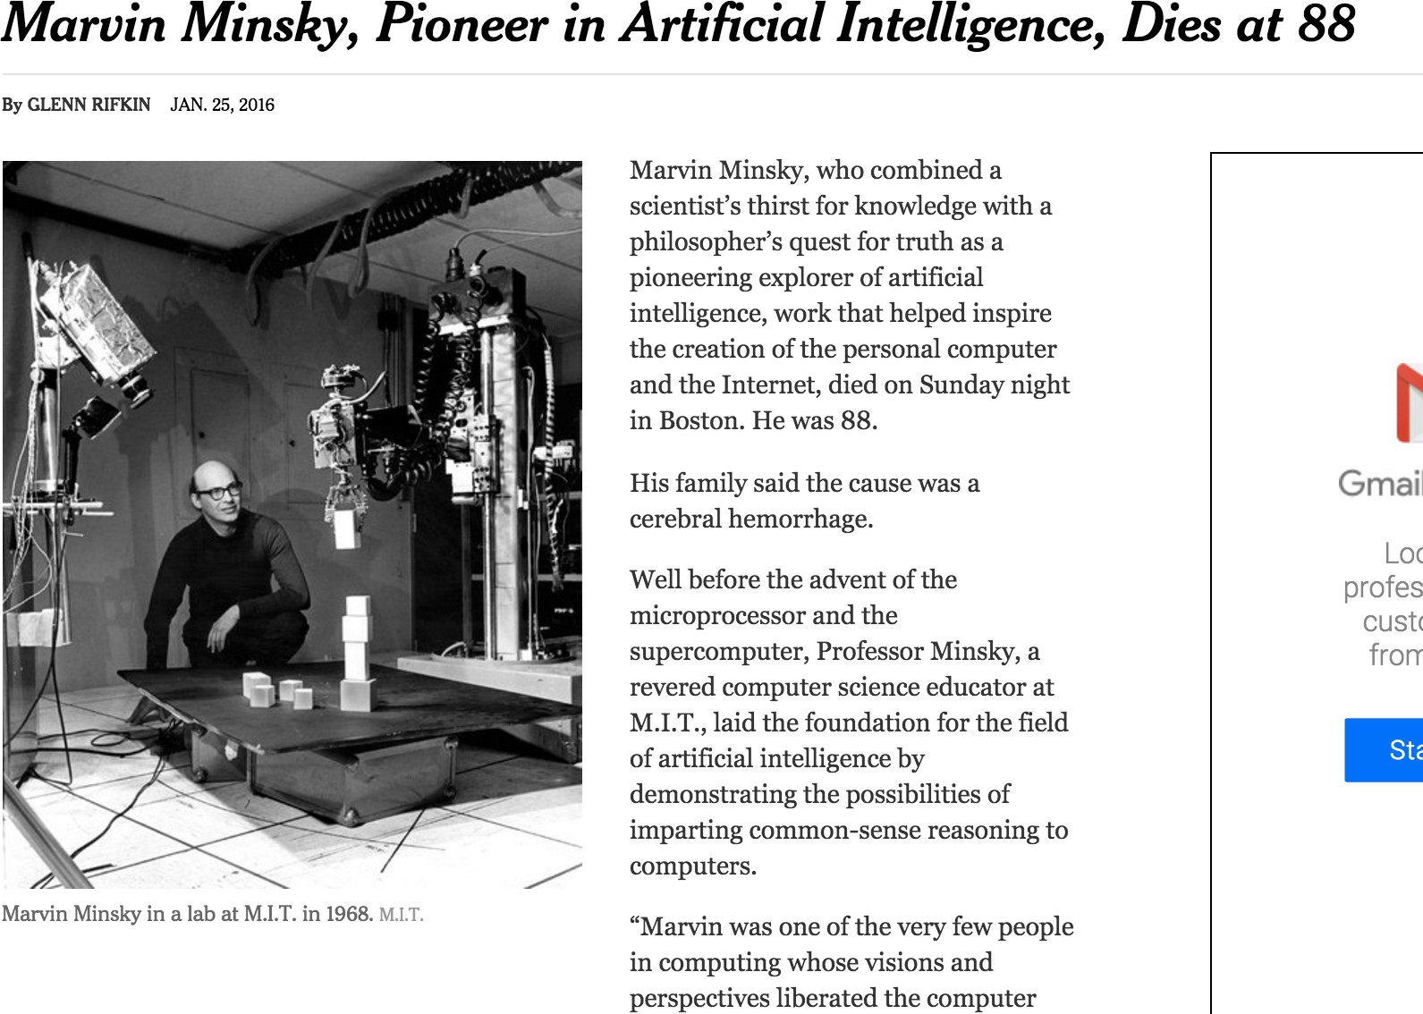

Slide 4
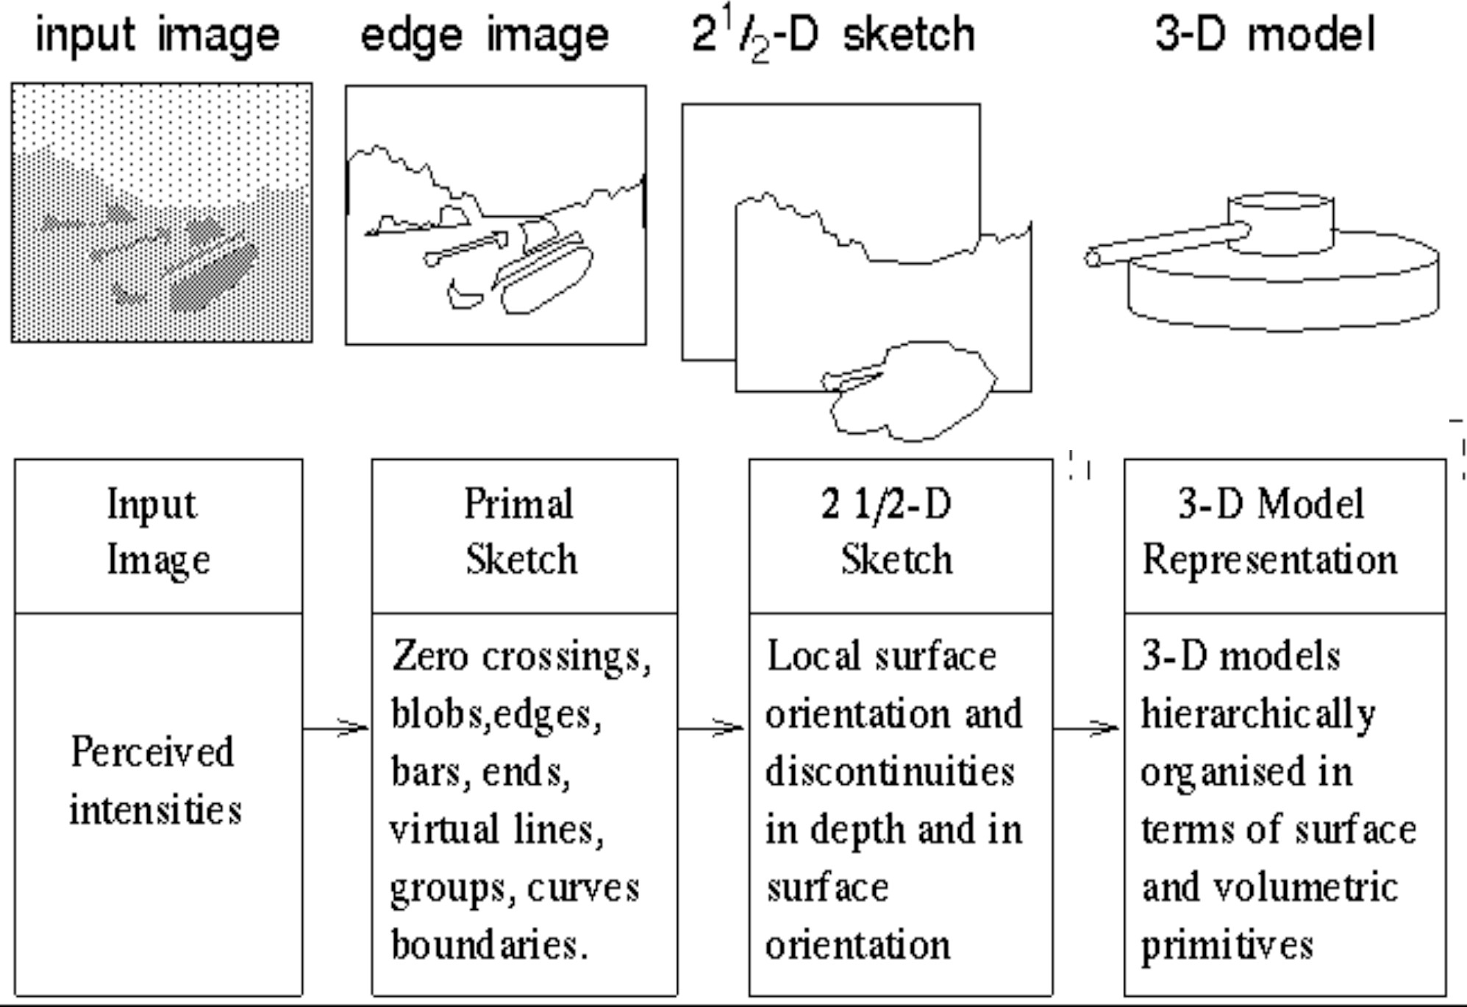
Stages of Visual Representation, David Marr, 1970

Slide 5
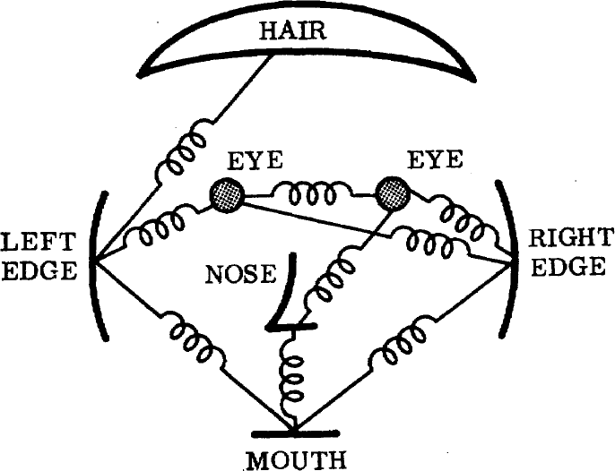
1973
The constellation model
The representation and matching of pictorial structures, Fischler and Elschlager, 1973

Slide 6
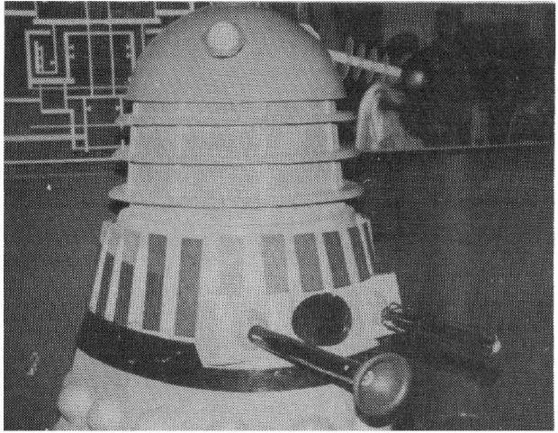
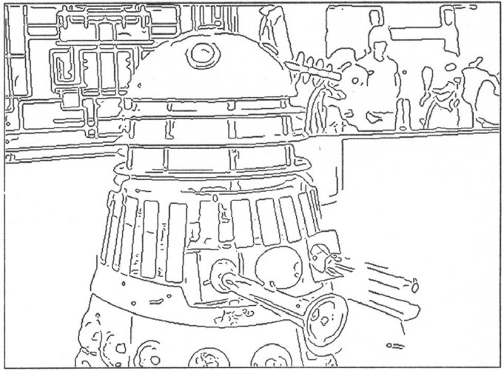
1980’s
AI winter…
…back to basics
A Computational Approach to Edge Detection, Canny 1986

Slide 7
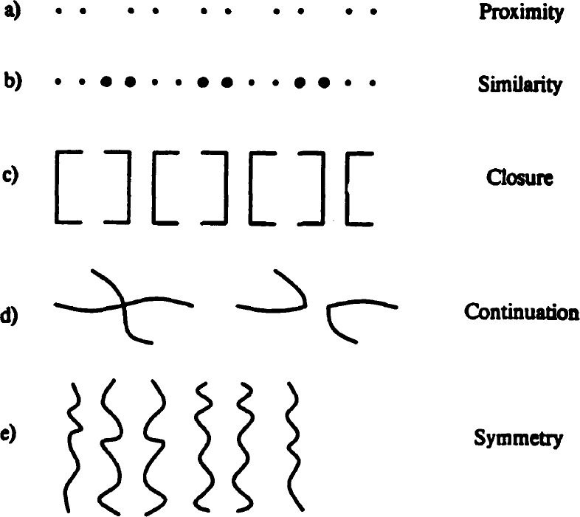
1984
Perceptual Organization and Visual Recognition, David Lowe, 1984

Slide 8
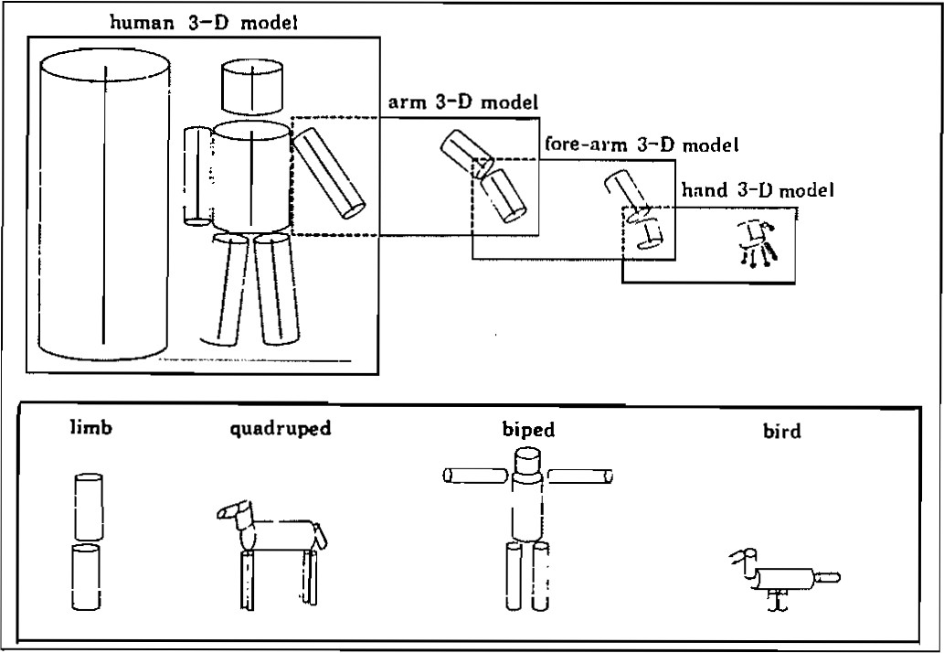
1986
Perceptual organization and the representation of natural form, Alex Pentland, 1986

Slide 9
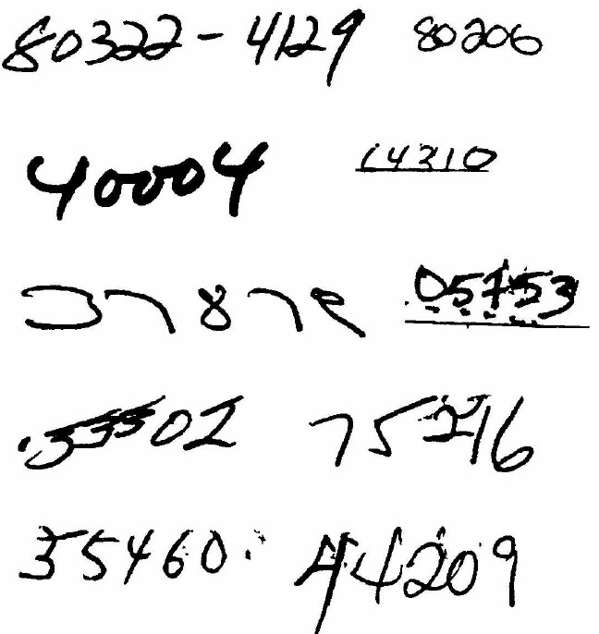
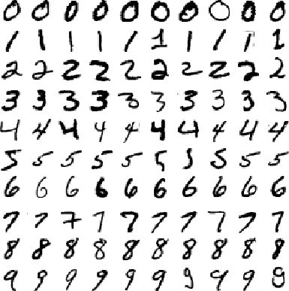
1989
MNIST
Zip codes
Backpropagation applied to handwritten zip code recognition, Lecun et al., 1989

Slide 10
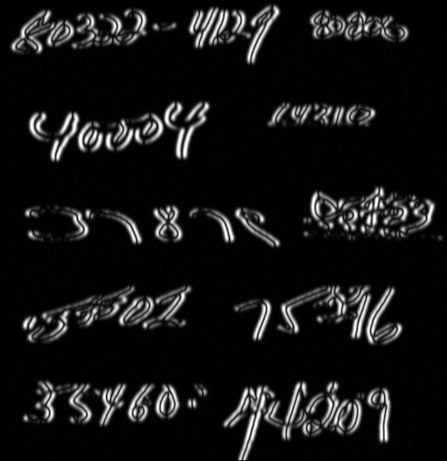
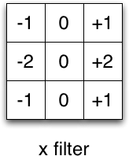
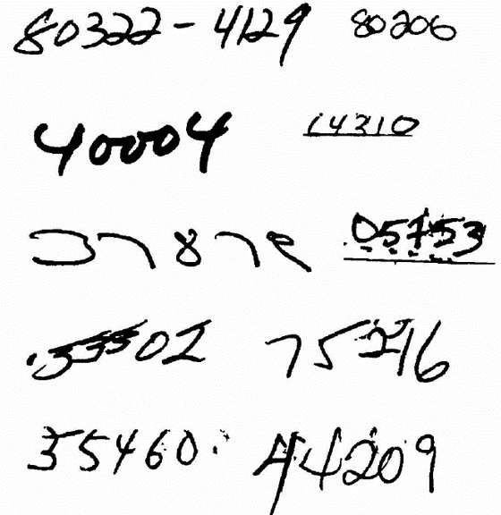
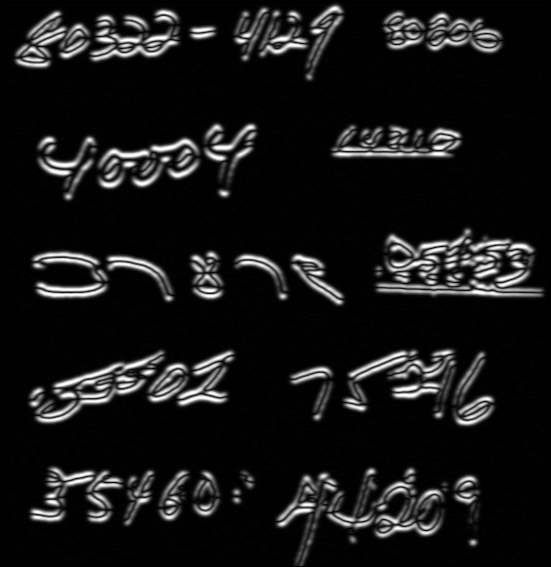
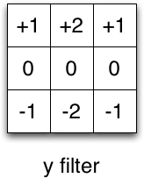
Filters
Input

Slide 11
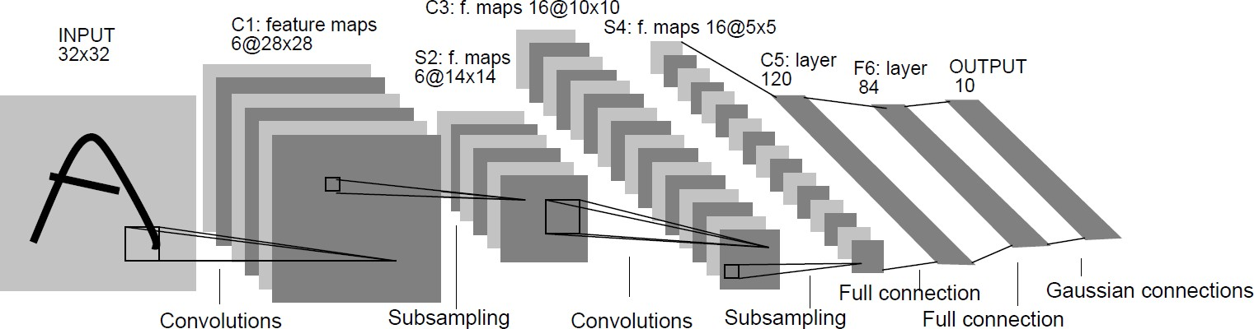
1989
Backpropagation applied to handwritten zip code recognition, Lecun et al., 1989

Slide 12
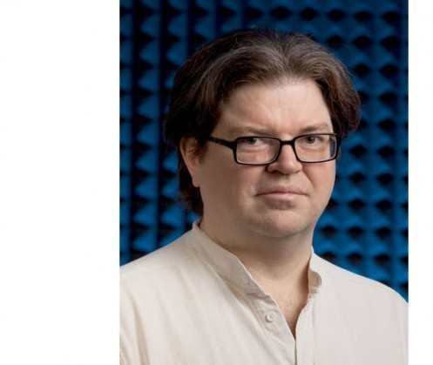
1989
Backpropagation applied to handwritten zip code recognition, Lecun et al., 1989

Slide 13
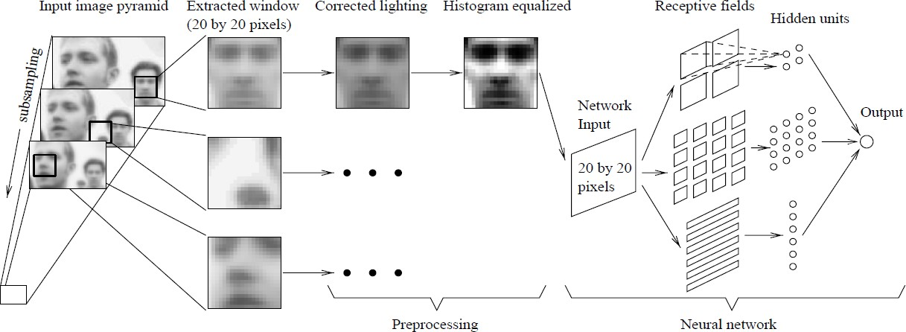
1998
Faces
Neural Network-­‐Based Face Detection, Rowley at al., PAMI 1998

Slide 14
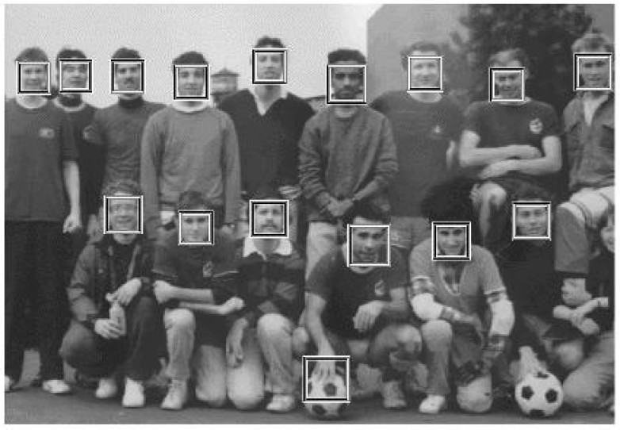
2001
Sliding window in real time!
Boosting + Cascade = Speed
Rapid Object Detection using a Boosted Cascade of Simple Features, Viola and Jones, CVPR 2001

Slide 15
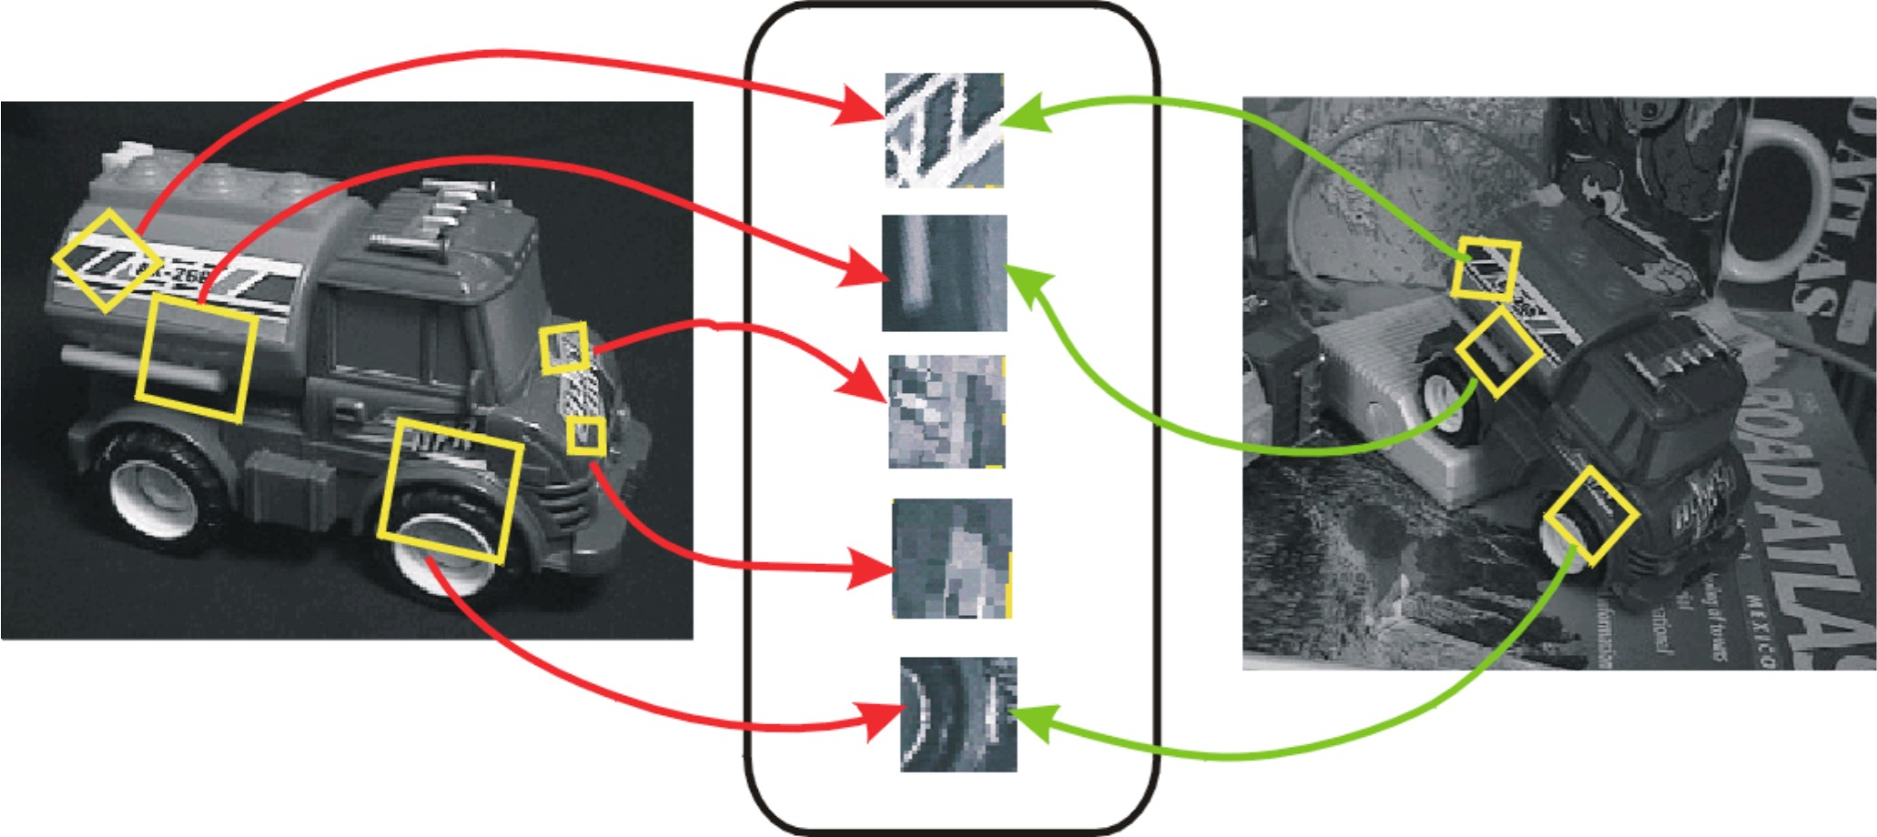
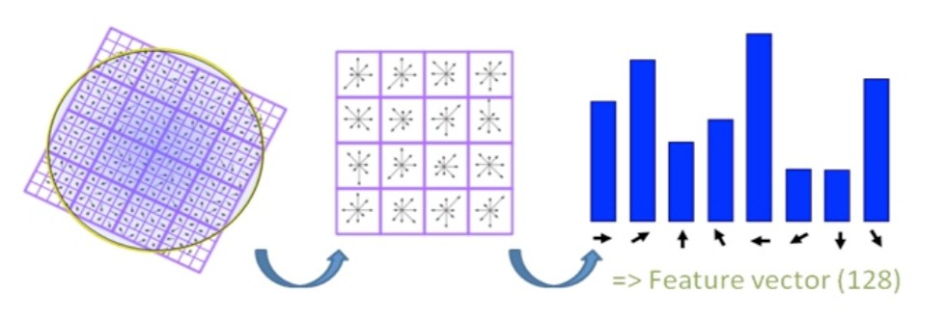
1999
SIFT
(Scale Invariant Feature Transform)
No more sliding windows (interest points) Better features (use more computation)
Object Recognition from Local Scale-­‐Invariant Features, Lowe, ICCV 1999.

Slide 16
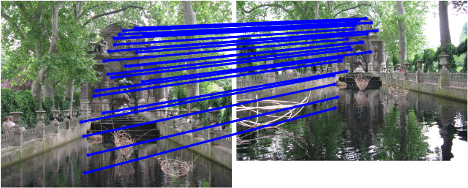
SIFT Matching
[SIFT: Lowe, 2004]

Slide 17
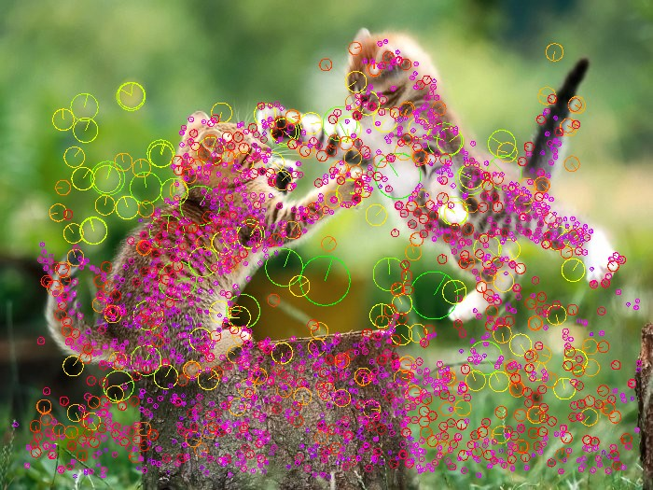
Interest points

Slide 18
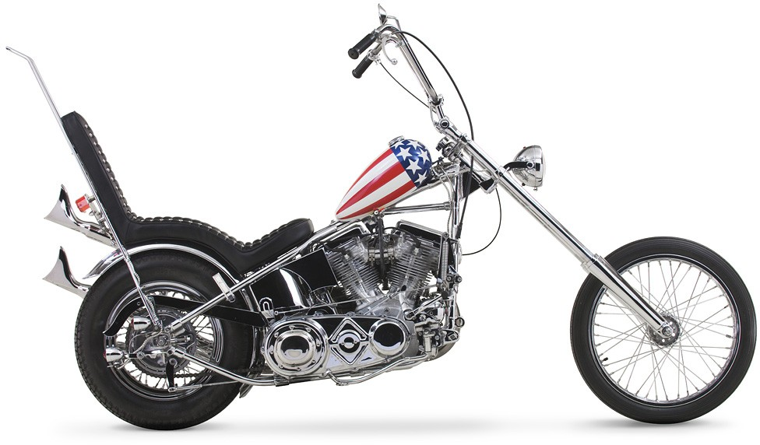


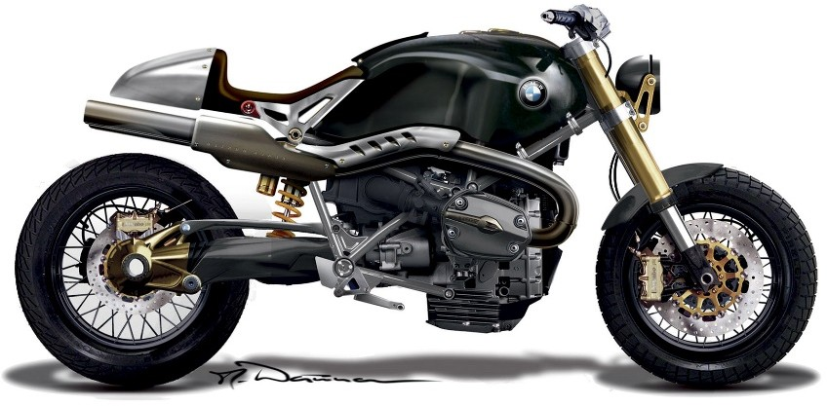





2003
Constellation model (redux)
Object Class Recognition by Unsupervised Scale-­‐Invariant Learning, Fergus et al., CVPR 2003.

Slide 19
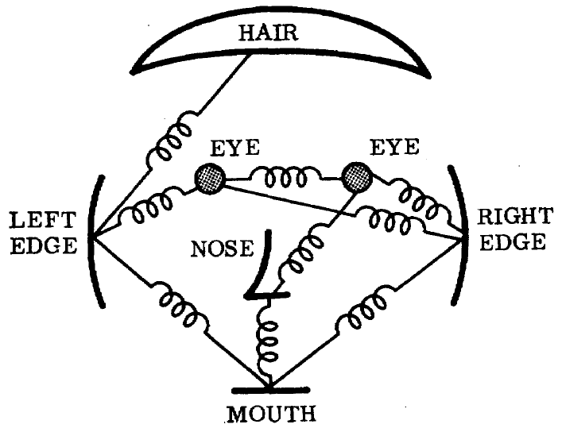
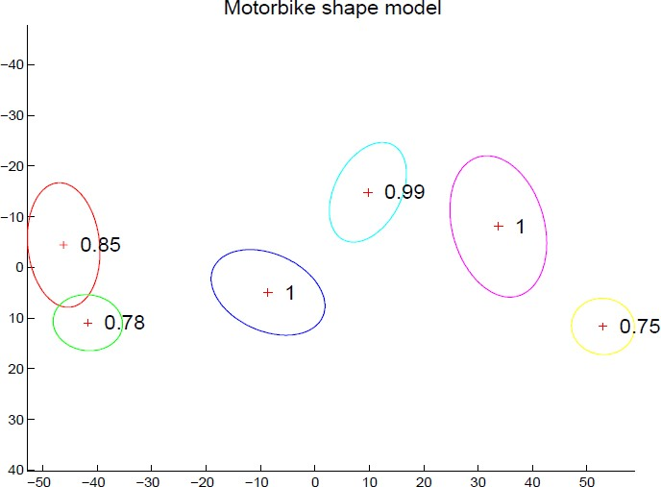
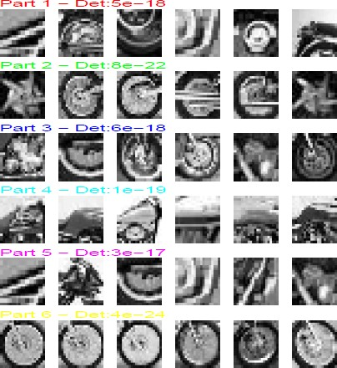
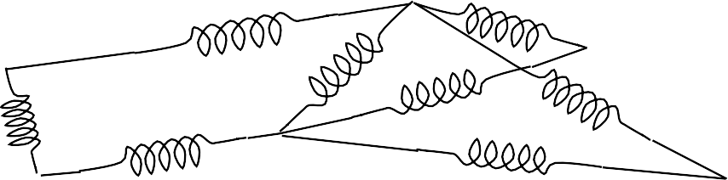
2003
Constellation model (redux)
The representation and matching of pictorial structures, Fischler and Elschlager, 1973
Joint Gaussian density

Slide 20
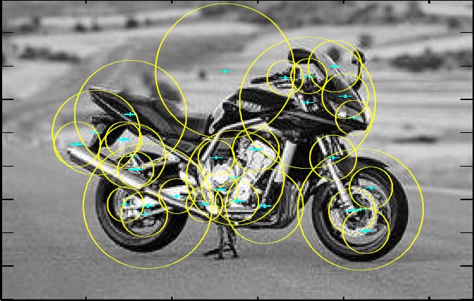
Interest points used to find parts:
Smaller number of candidate parts allows for more complex spatial models.

Slide 21
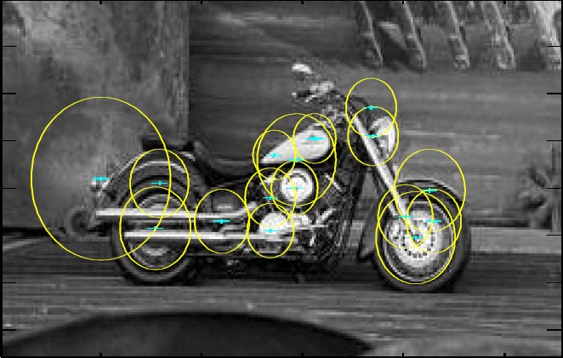
Why it fails
Interest points don’t work for category recognition

Slide 22
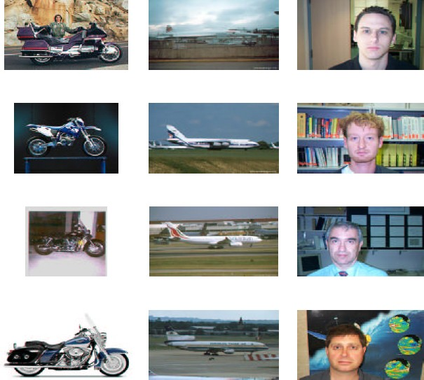
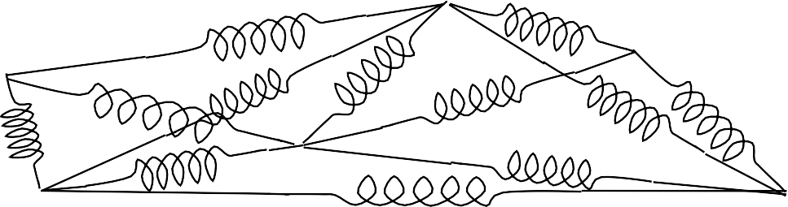
Too many springs…

Slide 23
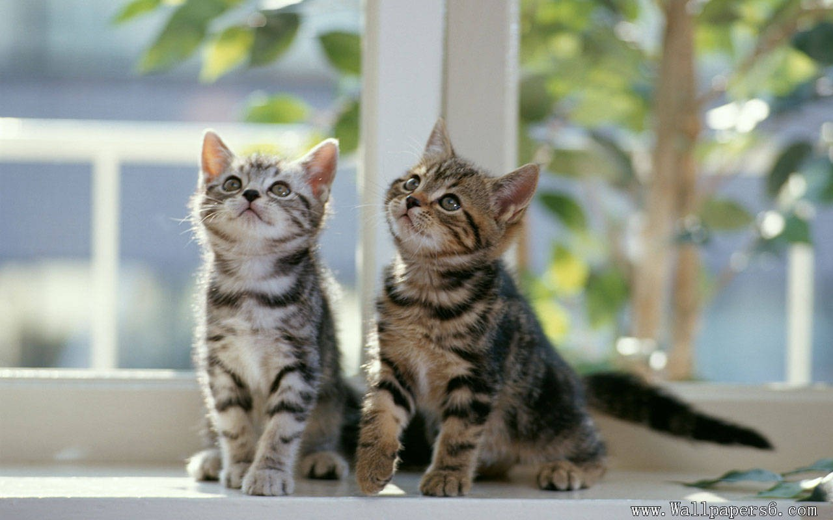
Classification
Vs.
Detection
✓✓ Cat
Cat
Cat

Slide 24
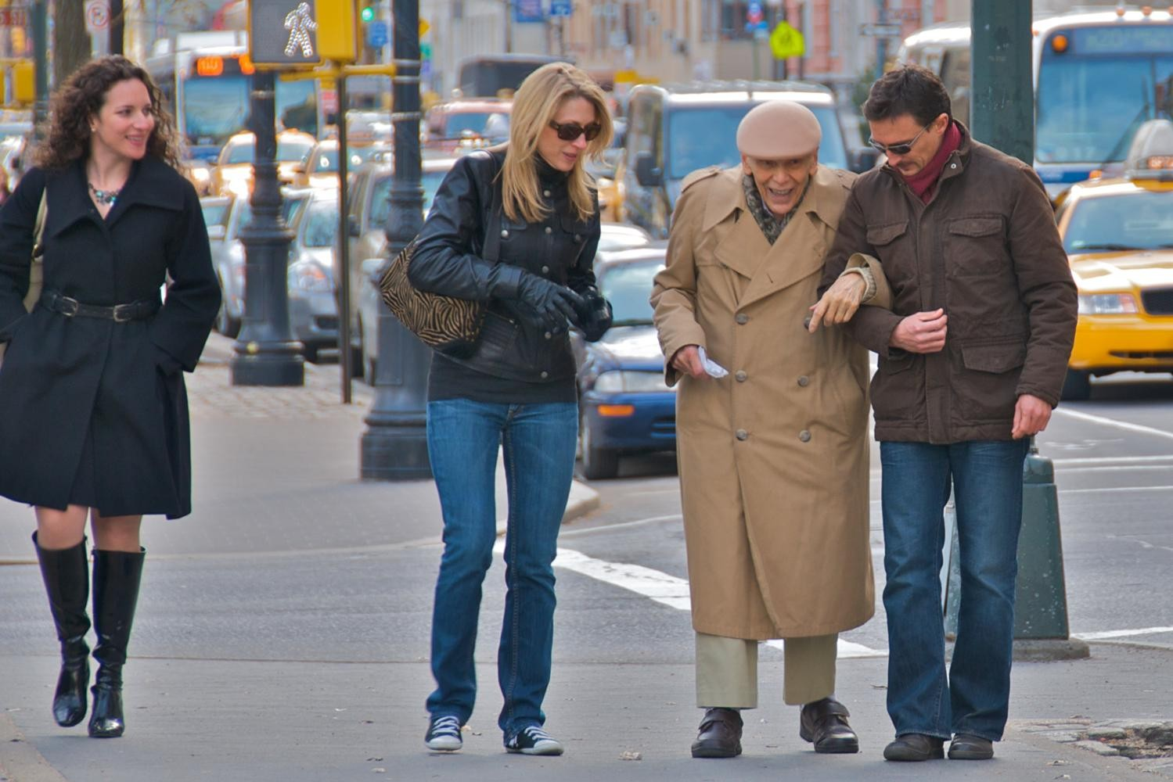
2005 HOG (histograms of oriented gradients)
Histograms of oriented gradients for human detection, Dalal and Triggs, CVPR 2005.

Slide 25
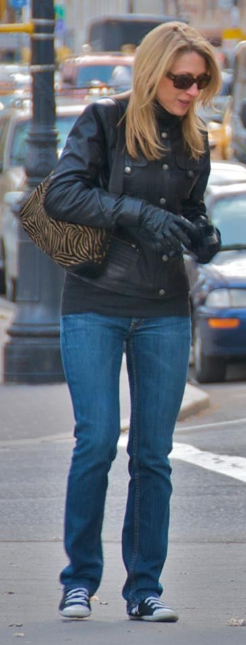
Pedestrians
Defined by their contours
Cluttered backgrounds
Significant variance in texture
Interest points won’t work…
…back to sliding window.

Slide 26

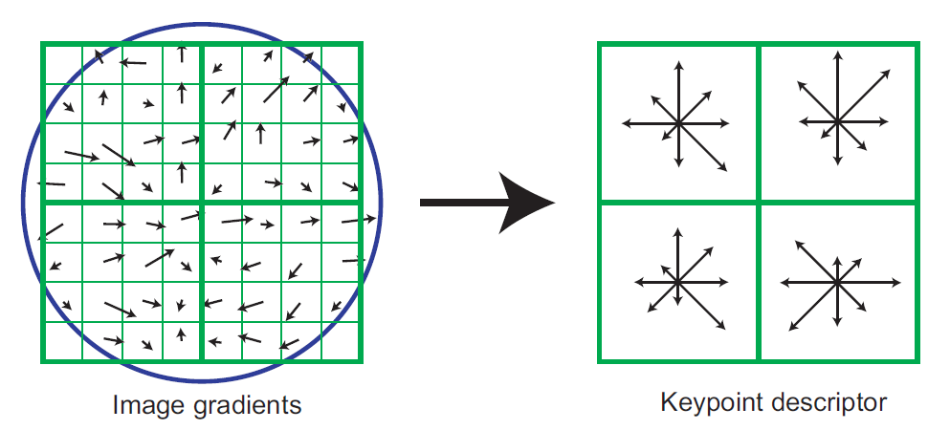
2005 HOG (histograms of oriented gradients)
SIFT

Slide 27
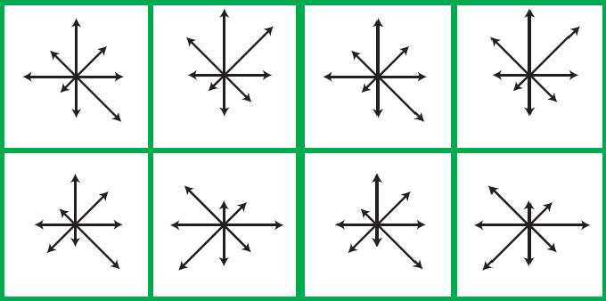
2005 HOG (histograms of oriented gradients)
Histograms of oriented gradients for human detection, Dalal and Triggs, CVPR 2005.

Slide 28
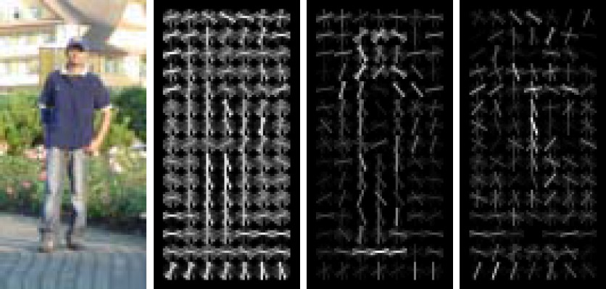
2005 HOG (histograms of oriented gradients)
Presence > Magnitude
✓✓ Normalization by a local window
Notes:
We can finally detect object boundaries in a reliable manner!
Hard negative mining Computers are fast enough.

Slide 29
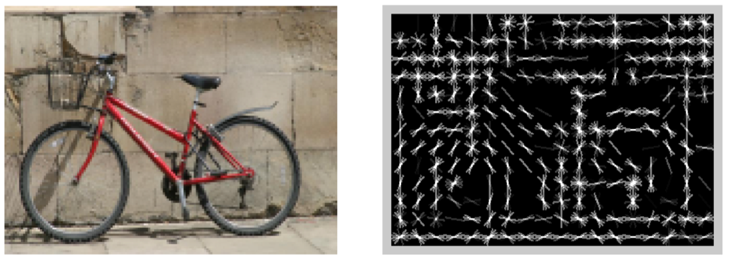
What’s this?
[Dalal and Triggs, 2005]

Slide 30
Yup.
Image
HoG

Slide 31
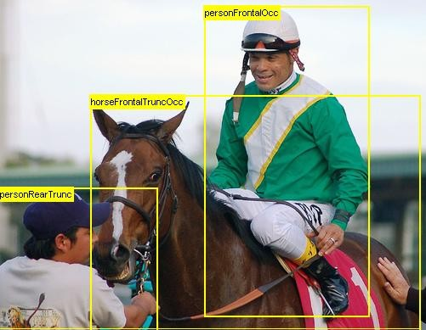
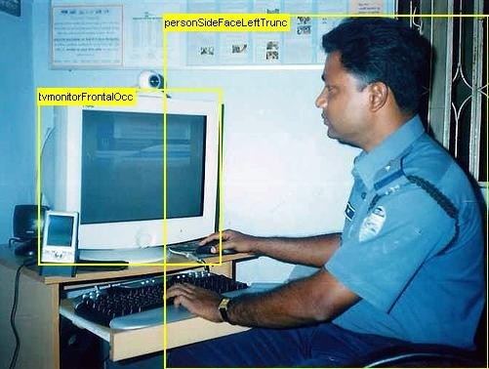
2007 PASCAL VOC
20 classes
The PASCAL Visual Object Classes (VOC) Challenge, Everingham, Van Gool, Williams, Winn and Zisserman, IJCV, 2010

Slide 32

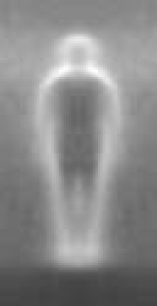
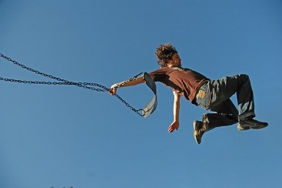

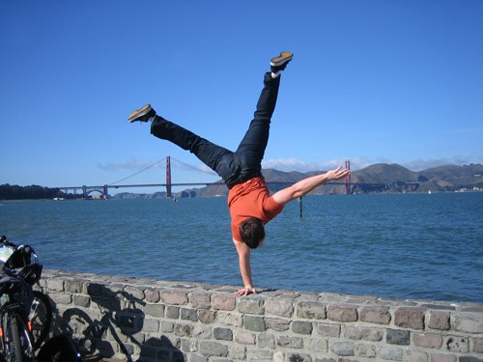
Why it is hard

Slide 33
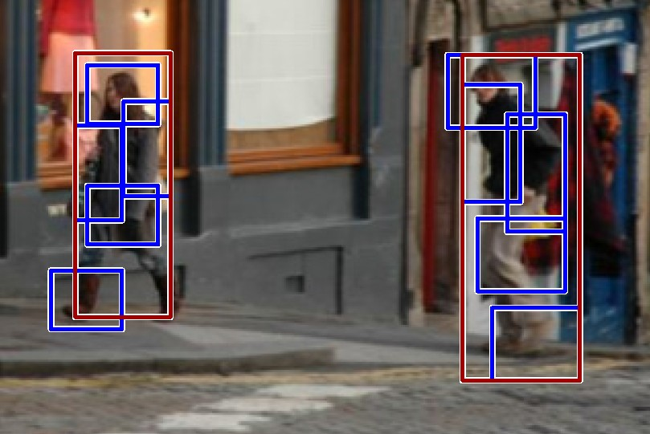
2008 DPM (Deformable parts model)
Object Detection with Discriminatively Trained Part Based Model,
Felzenszwalb, Girshick, McAllester and Ramanan, PAMI, 2010

Slide 34
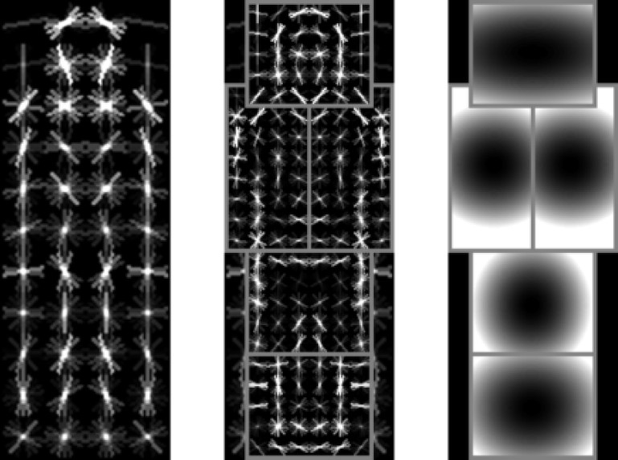
2008 DPM (Deformable parts model)
Object Detection with Discriminatively Trained Part Based Model,
Felzenszwalb, Girshick, McAllester and Ramanan, PAMI, 2010

Slide 35
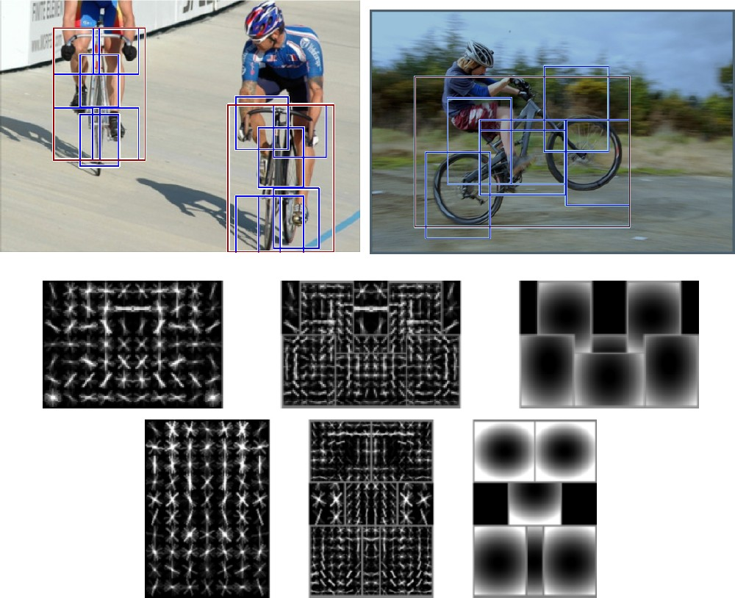
Multiple components
Notes:
Multiple components
Deformable parts?
Hard negative mining
Good balance

Slide 36
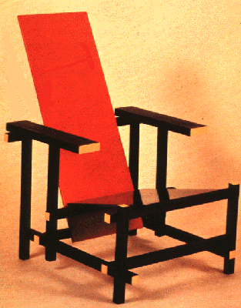






Problems with Visual Categories
A lot of categories are functional
Char
World is too varied
car
Categories are 3D, but images are 2D
57

Slide 37

Do We Need More Training Data or Better Models for Object Detection?
Zhu, Vondrick, Ramanan, Fowlkes, BMVC 2012.

Slide 38


Slide 39


2009 ImageNet
22K categories, 14M images Corgi
Orb weaving spider
ImageNet: A Large-­‐Scale Hierarchical Image Database,
Deng, Dong, Socher, Li, Li and Fei-­‐Fei, CVPR, 2009

Slide 40



Images
2009
2012
14M
ImageNet

Slide 41


Categories
2009
2012
22K
ImageNet

Slide 42



Algorithms
2012
Dense
Dense
Dense
2009
Convolution
Convolution
Pooling
Convolution
SVM
Convolution
HOG
Convolution
Image
Image

Slide 43


Slide 44


Slide 45


Slide 46


Slide 47


Slide 48


Slide 49


Slide 50


Slide 51


Going beyond categorization…
“Connect a television camera to a computer and get the machine to describe what it sees.”

Slide 52

Going beyond categorization…
“Connect a television camera to a computer and get the machine to describe what it sees.”

Slide 53

Going beyond categorization…
“Connect a television camera to a computer and get the machine to describe what it sees.”

Slide 54


Going beyond categorization…

Slide 55



Slide 56
1966
“Connect a television camera to a computer and get the machine to describe what it sees.”
Marvin Minsky Turing award, 1969

Slide 57

Notes:
https://www.youtube.com/watch?v=R2mC-NUAmMk

